Slide 1
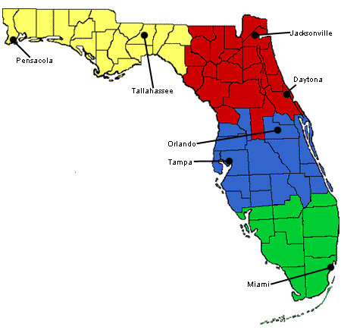
Developing A State Legislative Strategy for Asset Building: The Case of Florida
Webinar Hosted by
Joint Center for Political and Economic Studies
In Collaboration with the RAISE Florida Network
February 15, 2013
With Support from the Ford Foundation’s
Building Economic Security
Over a Lifetime (BESOL) Initiative
Notes:
.

Slide 2
Webinar Collaborators
Joint Center for Political and Economic Studies
… supports policy education efforts of BESOL coalitions
regarding best practices and effective strategies for asset building
RAISE Florida Network (RFN)
… is a statewide network of grassroots, community
and faith-based organizations, public and private institutions,
legislators and coalition leaders working together across
the State of Florida to develop, support, and expand equitable
asset building opportunities

Slide 3
Featured Speakers
Wilhelmina A. Leigh
Senior Research Associate
Joint Center for Political
and Economic Studies
Melissa R. Wells
Policy Assistant
Joint Center for Political
and Economic Studies

Slide 4
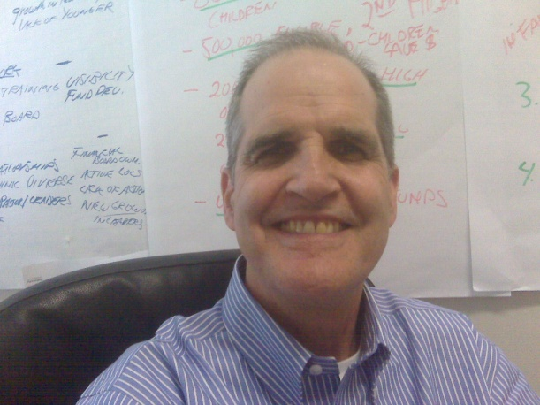
Featured Speaker
PICO United Florida
… has as its mission to build a powerful multicultural non partisan network of congregation community organizations in Florida that will address systemic racial and economic issues that cause poverty for our families
Peter Phillips
Executive Director

Slide 5
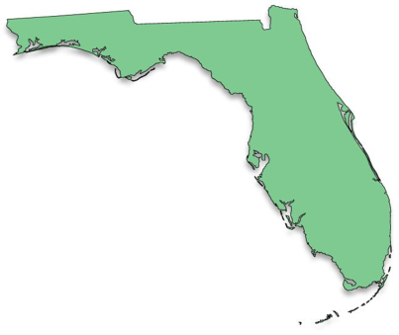
Purpose of Webinar
Present results from legislative analysis undertaken by the Joint Center to help the RFN advance its policy priorities
Share information about the ongoing legislative campaign in Florida around the Homeowner Bill of Rights

Slide 6
Guiding Questions for Legislative Analyses
What types of legislators and other key policy makers need to be engaged as champions for asset building?
How can potential champions be
identified?
What steps need to be taken to engage potential champions for asset building?

Slide 7
Outline of Presentation
Policy Priorities of RAISE Florida Network
Legislative Process in Florida
How to identify legislative champions
How to work with legislators
Questions and Answers

Slide 8
Policy Priorities of RAISE Florida Network
IDA (Individual Development Account) funding
Foreclosure abatement
predatory lending protection
Homeowner Bill of Rights
Microenterprise development
Financial Security

Slide 9
Legislative Process in Florida

Slide 10
Florida State Government

Slide 11
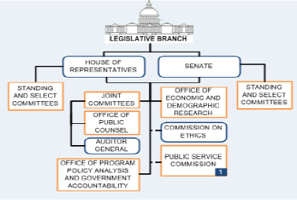
Florida’s Legislative Branch

Slide 12
Legislative Committee Structure
HOUSE OF REPRESENTATIVES
SENATE
Committee on ___
Committee on ___
Subcommittee on ___
Subcommittee on ___

Slide 13
How A Bill Becomes A Law: The Legislature
Notes:
-- Speaker: State that this slide presents general process and process is likely to vary by state. Perhaps mention some of the steps for legislation introduced and passed by Repr. Rouson.

Slide 14
How A Bill Becomes a Law: The State Governor

Slide 15
How to Identify Legislative Champions

Slide 16
Step One
Determine the legislators who
serve on the relevant committees
and subcommittees and note
their party affiliation and district

Slide 17
Step Two
Do your “homework” on these legislators. Explore the following:
… population mix in districts of legislators
… needs in districts of legislators
… previously sponsored relevant legislation
… personal and professional connections
… information from other kindred organizations
Notes:
-- Talk: Examples of personal/professional connections would be previous jobs held (by you or them), church membership, shopping relationships, civic memberships

Slide 18
Step Three
Based on your “homework,” decide
which legislators to engage

Slide 19
RFN Policy Priority: IDA Funding

Slide 20
IDA Funding: Relevant Committees
HOUSE OF REPRESENTATIVES
SENATE
Economic Affairs
Committee
Health and Human Services Committee
Committee on Commerce and Tourism
Economic Development and Tourism Subcommittee
Healthy
Families Subcommittee

Slide 21
IDA Funding: Relevant House Committee (Economic Affairs)
Economic Affairs Committee
Jimmy Patronis [R-06] Chair Tom Goodson[R-50] Vice Chair Alan B. Williams [D-08] Democratic Ranking Member Douglas Vaughn "Doug" Broxson [R-03] Michael Philip "Mike" Clelland [D-29] W. Travis Cummings [R-18] Mark Danish [D-63] Daniel Davis [R-15] Reggie Fullwood [D-13] Joseph A. "Joe" Gibbons [D-100] Ed Hooper [R-67] Jose R. Oliva [R-110] W. Keith Perry [R-21] Sharon Pritchett [D-102] Holly Merrill Raschein [R-120] Lake Ray, [R-12] Jimmie T. Smith [R-34] Carlos Trujillo [R-105]
Economic Development and Tourism Subcommittee
Carlos Trujillo [R-105] Chair Elizabeth W. Porter [R-10] Vice Chair Hazelle P. "Hazel" Rogers, [D-95] Democratic Ranking Member Ben Albritton, [R-56] Bruce Antone [D-46] Karen Castor Dentel [D-30] Neil Combee [R-39] Dane Eagle [R-77] Matt Hudson [R-80] Travis Hutson, [R-24] Betty Reed, [D-61] Jimmie T. Smith [R-34] Clovis Watson, Jr., [D-20]

Slide 22
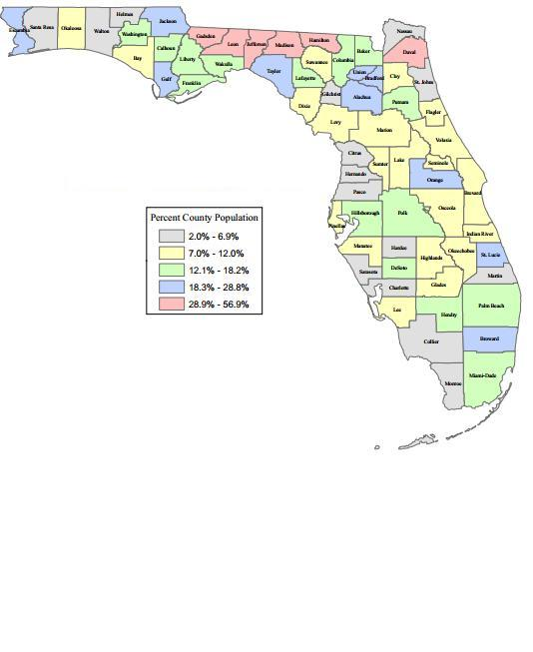
IDA Funding: House Committee (EA) Members From Districts with Sizable Black Populations
Economic Affairs Committee
Tom Goodson[R-50] Vice Chair
Alan B. Williams [D-08] Democratic Ranking Member
Daniel Davis [R-15]
Reggie Fullwood [D-13]
Joseph A. "Joe" Gibbons [D-100]
Jose R. Oliva [R-110]
W. Keith Perry [R-21]
Sharon Pritchett [D-102]
Holly Merrill Raschein [R-120]
Lake Ray, [R-12]
Carlos Trujillo [R-105]
Economic Development and Tourism Subcommittee
Carlos Trujillo [R-105] Chair Elizabeth W. Porter [R-10] Vice Chair Hazelle P. "Hazel" Rogers, [D-95] Democratic Ranking Member Bruce Antone [D-46] Karen Castor Dentel [D-30] Clovis Watson, Jr., [D-20]

Slide 23
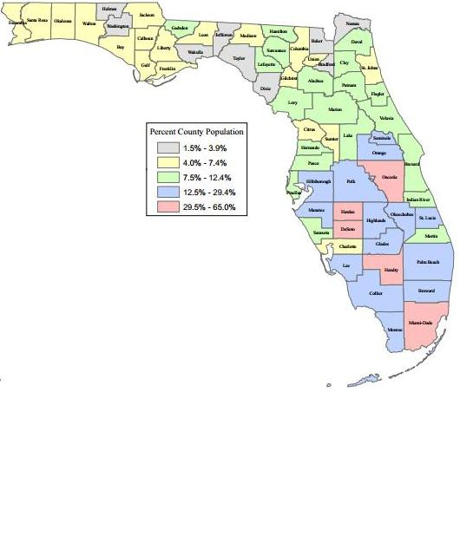
IDA Funding: House Committee (EA) Members From Districts with Sizable Latino Populations
Economic Affairs Committee
Tom Goodson[R-50] Vice Chair
Mark Danish [D-63]
Joseph A. "Joe" Gibbons [D-100]
Jose R. Oliva [R-110]
Sharon Pritchett [D-102]
Holly Merrill Raschein [R-120]
Carlos Trujillo [R-105]
Economic Development and Tourism Subcommittee
Carlos Trujillo [R-105] Chair Hazelle P. "Hazel" Rogers, [D-95] Democratic Ranking Member Ben Albritton, [R-56] Bruce Antone [D-46] Karen Castor Dentel [D-30] Neil Combee [R-39] Matt Hudson [R-80] Betty Reed, [D-61]

Slide 24
IDA Funding: House Committee (EA) Members and Relevant Caucuses
Legislative Black Caucus
Economic Affairs Committee (House)
Alan B. Williams [D-08] Democratic Ranking Member
Reggie Fullwood [D-13]
Joseph A. "Joe" Gibbons [D-100]
Sharon Pritchett [D-102]
Hispanic Legislative Caucus
Economic Affairs Committee (House)
Carlos Trujillo [R-105]
Economic Development and Tourism Subcommittee
Hazelle P. "Hazel" Rogers, [D-95] Democratic Ranking Member Bruce Antone [D-46] Betty Reed, [D-61] Clovis Watson, Jr., [D-20]
Economic Development and Tourism Subcommittee
Carlos Trujillo [R-105] Chair

Slide 25
IDA Funding: House Committee Members (EA) and Sponsored Legislation
Economic Affairs Committee
Debt Buyer Industry Regulation (HB 1399)
Alan B. Williams [D-08]
Community Development (HB 437)
Daniel Davis [R-15]
Children’s Initiatives (HB 411)
Reggie Fullwood [D-13]
Title Loans (HB 877)
Joseph A. "Joe" Gibbons [D-100]
Department of Economic Opportunity (HB 7007)
Unemployment Compensation Benefits (HB 319)
Carlos Trujillo [R-105]
Economic Development and Tourism Subcommittee
Resident Status for Tuition Purposes (HB 11)
Hazelle P. "Hazel" Rogers [D-95] Democratic Ranking Member
Reggie Fullwood [D-13]
Credit Counseling Services (HB 67)
Elizabeth W. Porter [R-10] Vice Chair

Slide 26
IDA Funding: Potential Champion (House EA)
Economic Affairs Committee
Alan B Williams [D-08]
Influence
Senior Policy Leader – Democratic Whip
Relevant Legislation
Sponsored bill to regulate the debt buyer industry and collection practices (HB 1399)
District
large proportion of African Americans (Gadsden)
High foreclosure rates
Northwest Florida
Notes:
Mention that Alan B Williams represents Gadsden County where African Americans are at least 50% of the population (based on 2010 Census)

Slide 27
IDA Funding: Potential Champion (House EA)
Economic Affairs Committee
Reggie Fullwood [D-13]
Relevant Legislation
Sponsored children’s initiative bill (HB 441)
District
Represents a district with a large proportion of African Americans (Duval)
Northeast Florida

Slide 28
IDA Funding: Potential Champion (House EA)
Economic Affairs Committee
Daniel Davis [R-15]
Relevant Legislation
Sponsored community development bill (HB 437)
Co-Sponsored by Rep. Fullwood [D-13]
District
Represents a district with a large proportion of African Americans (Duval)
Northeast Florida

Slide 29
IDA Funding: Potential Champion (House EA)
Economic Affairs Committee
Joseph A. Gibbons [D-100]
Relevant Legislation
Sponsored bill to regulate the title loans industry (HB 877)
District
Represents a district with a large proportion of African Americans and Latinos (Broward & Miami-Dade)
Southeast Florida

Slide 30
IDA Funding: Potential Champion (House EA)
Economic Affairs Committee
Carlos Trujillo [D-105]
Relevant Legislation
Sponsored Department of Economic Opportunity bill (HB 7007)
Sponsored Unemployment Compensation Benefits bill (HB 319)
District
Represents a district with a large proportion of African Americans and Latinos (Broward , Collier and Miami-Dade)
Southeast and Southwest Florida

Slide 31
IDA Funding: Potential Champion (House EA)
Economic Development and Tourism Subcommittee
Elizabeth W. Porter [R-10]
Influence
Vice Chair on Economic Development and Tourism Subcommittee
Relevant Legislation
Sponsored Credit Counseling Services bill (HB 67)
District
Represents a district with a large proportion of African Americans (Hamilton and Alachua)
North and Northwest Florida

Slide 32
IDA Funding: Potential Champion (House EA)
Economic Development and Tourism Subcommittee
Reggie Fullwood [D-13]
Relevant Legislation
Sponsored the Resident Status for Tuition Purposes bill (HB 11)
District
Represents a district with a large proportion of African Americans (Duval)
Northeast Florida

Slide 33
IDA Funding: Potential Champion (House EA)
Economic Development and Tourism Subcommittee
Hazelle P. Rogers [D-95]
Influence
Democratic Ranking Member on the Economic Development and Tourism Subcommittee
Relevant Legislation
Sponsored the Resident Status for Tuition Purposes bill (HB 11)
District
Represents a district with a large proportion of African Americans and Latinos (Broward)
Southwest Florida

Slide 34
IDA Funding: Relevant Committees
HOUSE OF REPRESENTATIVES
SENATE
Economic Affairs
Committee
Health and Human Services Committee
Committee on Commerce and Tourism
Economic Development and Tourism Subcommittee
Healthy
Families Subcommittee

Slide 35
IDA Funding: Relevant House Committee (Health and Human Services)
Health and Human Services Committee
Richard Corcoran [R-37] Chair Larry Ahern [R-66] Vice Chair Mia L. Jones [D-14] Democratic Ranking Member Gwyndolen "Gwyn" Clarke-Reed [D-92] W. Travis Cummings [R-18] Katie A. Edwards [D-98] Mike Fasano [R-36] Joseph A. "Joe" Gibbons [D-100] Gayle B. Harrell [R-83] Shevrin D. "Shev" Jones [D-101] Mark S. Pafford [D-86] Jimmy Patronis [R-06] Cary Pigman [R-55] Ronald "Doc" Renuart [R-17] Kenneth L. "Ken" Roberson [R-75] Elaine J. Schwartz [D-99] John Tobia, [R-53] John Wood [R-41]
Healthy Families Subcommittee
Gayle B. Harrell B. [R-83] Chair W. Keith Perry [R-21] Vice Chair Lori Berman [D-90] Democratic Ranking Member Heather Dawes Fitzenhagen [R-78] Shevrin D. "Shev" Jones [D-101] Kathleen M. Peters [R-69] Cary Pigman [R-55] Bobby Powell [D-88] Sharon Pritchett [D-102] Kevin Rader [D-81] Ray Wesley Rodrigues [R-76] Patrick Rooney, Jr. [R-85] Carlos Trujillo [R-105]

Slide 36
IDA Funding: House Committee Members (HHS) From Districts with Sizable Black Populations
Health and Human Services Committee
Mia L. Jones [D-14] Democratic Ranking Member
Gwyndolen "Gwyn" Clarke-Reed [D-92]
Katie A. Edwards [D-98]
Joseph A. "Joe" Gibbons [D-100]
Gayle B. Harrell [R-83]
Shevrin D. "Shev" Jones [D-101]
Cary Pigman [R-55]
Elaine J. Schwartz [D-99]
Healthy Families Subcommittee
Gayle B. Harrell B. [R-83] Chair W. Keith Perry [R-21] Vice Chair Shevrin D. "Shev" Jones [D-101] Cary Pigman [R-55] Sharon Pritchett [D-102] Carlos Trujillo [R-105]

Slide 37
IDA Funding: House Committee Members (HHS) From Districts with Sizable Latino Populations
Health and Human Services Committee
Gwyndolen "Gwyn" Clarke-Reed [D-92]
Katie A. Edwards [D-98]
Joseph A. "Joe" Gibbons [D-100]
Gayle B. Harrell [R-83]
Shevrin D. "Shev" Jones [D-101]
Mark S. Pafford [D-86]
Cary Pigman [R-55]
Elaine J. Schwartz [D-99]
John Wood [R-41]
Healthy Families Subcommittee
Gayle B. Harrell B. [R-83] Chair Lori Berman [D-90] Democratic Ranking Member Heather Dawes Fitzenhagen [R-78] Shevrin D. "Shev" Jones [D-101] Cary Pigman [R-55] Bobby Powell [D-88] Sharon Pritchett [D-102] Kevin Rader [D-81] Ray Wesley Rodrigues [R-76] Patrick Rooney, Jr. [R-85] Carlos Trujillo [R-105]

Slide 38
IDA Funding: House Committee Members (HHS) and Relevant Caucuses
Legislative Black Caucus
Health and Human Services Committee
Mia L. Jones [D-14] Democratic Ranking Member
Gwyndolen "Gwyn" Clarke-Reed [D-92]
Joseph A. "Joe" Gibbons [D-100]
Shevrin D. "Shev" Jones [D-101]
Healthy Families Subcommittee
Shevrin D. "Shev" Jones [D-101] Bobby Powell [D-88] Sharon Pritchett [D-102] Kevin Rader [D-81]
Hispanic Legislative Caucus
Health and Human Services Committee
Healthy Families Subcommittee
Ray Wesley Rodrigues [R-76]

Slide 39
IDA Funding: House Committee Members (HHS) and Sponsored Legislation
Health and Human Services Committee
Office of Minority Health (HB 459)
Mia L. Jones [D-14] Democratic Ranking Member
Career and Adult Education Programs (HB 331)
OGSR/Economic Development Agencies (HB 7115)
Jimmy Patronis [R-06]
Title Loans (HB 877)
Joseph A. "Joe" Gibbons [D-100]
Healthy Families Subcommittee
Department of Economic Opportunity (HB 7007)
Unemployment Compensation Benefits (HB 319)
Carlos Trujillo [R-105]
Enterprise Zones/City of Delray Beach (HB 255)
Job Incentives (HB 207)
Employment of the Homeless (HB 197)
Lori Berman [D-90] Democratic Ranking Member

Slide 40
IDA Funding: Potential Champion (House HHS)
Health and Human Services Committee
Jimmy Patronis [R-06]
Relevant Legislation
Sponsored Career and Adult Education Programs bill (HB 331)
Sponsored Economic Development Agencies bill (HB 7115)
District
Panhandle Region

Slide 41
IDA Funding: Potential Champion (House HHS)
Health and Human Services Committee
Mia L. Jones [D-14]
Influence
Democratic Ranking Member on Health and Human Services Committee
Relevant Legislation
Sponsored Office of Minority Health bill (HB 459)
District
Represents a district with a large proportion of African Americans (Duval)
Northeast Florida

Slide 42
IDA Funding: Potential Champion (House HHS)
Health and Human Services Committee
Joseph A. Gibbons [D-100]
Relevant Legislation
Sponsored bill to regulate the title loans industry (HB 877)
District
Represents a district with a large proportion of African Americans and Latinos (Broward & Miami-Dade)
Southeast Florida

Slide 43
IDA Funding: Potential Champion (House HHS)
Healthy Families Subcommittee
Lori Berman [D-90]
Relevant Legislation
Sponsored Enterprise Zones/City of Delray Beach bill (HB 225)
Sponsored Job Incentives bill (HB 207)
Sponsored Employment of the Homeless bill (HB 197)
District
Represents a district with a large proportion of Latinos
Southeast Florida

Slide 44
IDA Funding: Potential Champion (House HHS)
Healthy Families Subcommittee
Carlos Trujillo [D-105]
Relevant Legislation
Sponsored Department of Economic Opportunity bill (HB 7007)
Sponsored Unemployment Compensation Benefits bill (HB 319)
District
Represents a district with a large proportion of African Americans and Latinos (Broward , Collier and Miami-Dade)
Southeast and Southwest Florida

Slide 45
IDA Funding: Relevant Committees
HOUSE OF REPRESENTATIVES
SENATE
Economic Affairs
Committee
Health and Human Services Committee
Committee on Commerce and Tourism
Economic Development and Tourism Subcommittee
Healthy
Families Subcommittee

Slide 46
IDA Funding: Relevant Senate Committee (Commerce and Tourism)
Committee on Commerce and Tourism
Nancy C. Detert [R-28] Chair
Joseph Abruzzo [D-25] Vice Chair
Aaron Bean [R-04]
Alan Hays [R-11]
Dorothy L. Hukill [R-08]
Gwen Margolis [D-35]
Garrett Richter [R-23]
Jeremy Ring [D-29]
Wilton Simpson [R-18]
Kelli Stargel [R-15]
Geraldine F. "Geri" Thompson [D-12]

Slide 47
IDA Funding: Senate Committee Members (CT) From Districts with Sizable Black Populations
Committee on Commerce and Tourism
Nancy C. Detert [R-28] Chair
Aaron Bean [R-04]
Alan Hays [R-11]
Gwen Margolis [D-35]
Jeremy Ring [D-29]
Kelli Stargel [R-15]
Geraldine F. "Geri" Thompson [D-12]

Slide 48
IDA Funding: Senate Committee Members (CT) From Districts with Sizable Latino Populations
Committee on Commerce and Tourism
Joseph Abruzzo [D-25] Vice Chair
Gwen Margolis [D-35]
Garrett Richter [R-23]
Jeremy Ring [D-29]
Kelli Stargel [R-15]
Geraldine F. "Geri" Thompson [D-12]

Slide 49
IDA Funding: Senate Committee Members (CT) and Relevant Caucus
Legislative Black Caucus
Committee on Commerce and Tourism
Geraldine F. "Geri" Thompson [D-12]

Slide 50
IDA Funding: Senate Committee Members (CT) and Sponsored Legislation
Committee on Commerce and Tourism
Employment Practices (CS/SB 100)
Reemployment Assistance
Nancy C. Detert [R-28] Chair
Resident Status for Tuition Purpose (SB 0268)
Joseph Abruzzo [D-25] Vice Chair
Community Development Block Grants (SB 494)
Wilton Simpson [R-18]
Enterprise Zones (SB 480)
Kelli Stargel [R-15]

Slide 51
IDA Funding: Potential Champion (Senate CT)
Committee on Commerce and Tourism
Geraldine F. “Geri” Thompson [D-12]
District
Represents a district with a large proportion of African Americans and Latinos
East Central Florida
Notes:
-- Speaker: State that Repr. Thompson is serving her first term in the Senate and that she is a member of the Florida Legislative Black Caucus.

Slide 52
IDA Funding: Potential Champion (Senate CT)
Committee on Commerce and Tourism
Kelli Stargel [R-15]
Relevant Legislation
Sponsored Enterprise Zones bill (SB 480)
District
Represents a district with a large proportion of African Americans and Latinos
East Central and West Central Florida

Slide 53
IDA Funding: Potential Champion (Senate CT)
Committee on Commerce and Tourism
Wilton Simpson [R-18]
Relevant Legislation
Sponsored Community Development Block Grants bill (SB 494)
District
North and West Central Florida

Slide 54
IDA Funding: Potential Champion (Senate CT)
Committee on Commerce and Tourism
Joseph Abruzzo [D-25]
Influence
Vice Chair of the Committee on Commerce and Tourism
Relevant Legislation
Sponsored Resident Status for Tuition Purpose bill (SB 0268)
District
Represents a district with a large proportion of African Americans and Latinos
Southwest Florida

Slide 55
IDA Funding: Potential Champion (Senate CT)
Committee on Commerce and Tourism
Nancy Detert [R-28]
Influence
Chair of the Committee on Commerce and Tourism
Relevant Legislation
Sponsored Employment Practices bill (SB 100)
District
West Central Florida

Slide 56
RFN Policy Priority: Predatory Lending Protection

Slide 57
Predatory Lending Protection: Relevant Committees
HOUSE OF REPRESENTATIVES
SENATE
Regulatory Affairs
Committee
Banking and Insurance Committee
Insurance and Banking Subcommittee

Slide 58
Predatory Lending Protection (PLP): Relevant House Committee (Regulatory Affairs)
Regulatory Affairs Committee
Doug Holder, [R-74] Chair Patrick Rooney, Jr. [R-85] Vice Chair James W. “Jim” Waldman [D-96] Democratic Ranking Member Halsey Beshears [R-7] Neil Combee [R-39] Jose Felix Diaz [R-116] Clay Ford [R-2] Erik Fresen [R-114] Larry Lee, Jr. [D-84] Debbie Mayfield [R-54] Bryan Nelson [R-31] Daniel D. “Dan” Raulerson [R-58] Darryl Ervin Rouson [D-70] Richard Stark [D-104] W. Gregory "Greg" Steube [R-73] Linda Stewart [D-47] Barbara Watson [D-107] Alan B. Williams [D-08]
Insurance and Banking Subcommittee
Bryan Nelson [R-31] Chair Bill Hager [R-89] Vice Chair Dwayne L. Taylor [D-26] Democratic Ranking Member Douglas Vaughn "Doug“ Broxson [R-03] Matthew H. "Matt“ Caldwell [R-79] Tom Goodson [R-50] Clay Ingram [R-01] Shevrin D. “Shev” Jones [D-101] Larry Lee, Jr. [D-84] George R. Moraitis, Jr. [R-93] Kevin Rader [D-81] David Santiago [R-27] John Tobia [R-53]

Slide 59
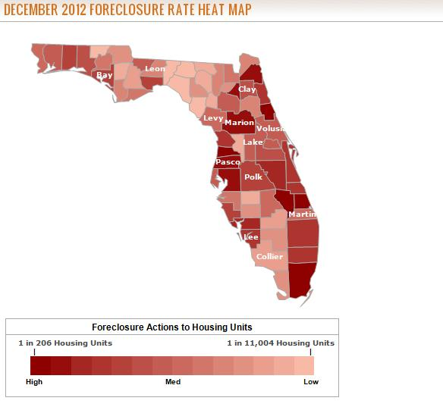
PLP: House Committee Members (RA) Representing High Foreclosure Districts
Regulatory Affairs Committee
Doug Holder, [R-74] Chair
Patrick Rooney, Jr. [R-85] Vice Chair
James W. “Jim” Waldman [D-96] Democratic Ranking Member
Neil Combee [R-39]
Jose Felix Diaz [R-116]
Erik Fresen [R-114]
Larry Lee, Jr. [D-84]
Debbie Mayfield [R-54]
Daniel D. “Dan” Raulerson [R-58]
Darryl Ervin Rouson [D-70]
Richard Stark [D-104]
W. Gregory "Greg" Steube [R-73]
Barbara Watson [D-107]
Alan B. Williams [D-08]
Insurance and Banking Subcommittee
Bill Hager [R-89] Vice Chair Douglas Vaughn "Doug“ Broxson [R-03] Tom Goodson [R-50] Shevrin D. “Shev” Jones [D-101] Larry Lee, Jr. [D-84] George R. Moraitis, Jr. [R-93] Kevin Rader [D-81] John Tobia [R-53]

Slide 60
PLP: House Committee Members (RA) From Districts with Sizable Black Populations
Regulatory Affairs Committee
James W. “Jim” Waldman [D-96] Democratic Ranking Member
Jose Felix Diaz [R-116]
Erik Fresen [R-114]
Larry Lee, Jr. [D-84]
Bryan Nelson [R-31]
Linda Stewart [D-47]
Barbara Watson [D-107]
Alan B. Williams [D-08]
Insurance and Banking Subcommittee
Bryan Nelson [R-31] Chair Tom Goodson [R-50] Clay Ingram [R-01] Larry Lee, Jr. [D-84]
Shevrin D. “Shev” Jones [D-101] George R. Moraitis, Jr. [R-93] John Tobia [R-53]
Notes:
-- African Americans (AAs) are 16% of the Florida state population. This list is comprised of legislators that represent counties where AAs represent at least 20% of the population. I will name counties where AAs are 30% to 50% of the population (Gadsden county Aas are 55% of the pop).

Slide 61
PLP: House Committee Members (RA) From Districts with Sizable Latino Populations
Regulatory Affairs Committee
Patrick Rooney, Jr. [R-85] Vice Chair
James W. “Jim” Waldman [D-96] Democratic Ranking Member
Neil Combee [R-39]
Jose Felix Diaz [R-116]
Erik Fresen [R-114]
Larry Lee, Jr. [D-84]
Bryan Nelson [R-31]
Daniel D. “Dan” Raulerson [R-58]
Darryl Ervin Rouson [D-70]
Richard Stark [D-104]
Linda Stewart [D-47]
Barbara Watson [D-107]
Insurance and Banking Subcommittee
Bryan Nelson [R-31] Chair Bill Hager [R-89] Vice Chair Tom Goodson [R-50] Shevrin D. “Shev” Jones [D-101] Larry Lee, Jr. [D-84] George R. Moraitis, Jr. [R-93] Kevin Rader [D-81]

Slide 62
PLP: House Committee Members (RA) and Relevant Caucuses
Legislative Black Caucus
Regulatory Affairs Committee (House)
Darryl Ervin Rouson [D-70]
Larry Lee, Jr. [D-84]
Barbara Watson [D-107]
Alan B. Williams [D-08]
Insurance and Banking Subcommittee
Dwayne L. Taylor [D-26] Democratic Ranking Member
Shevrin D. “Shev” Jones [D-101] Larry Lee, Jr. [D-84]
Insurance and Banking Subcommittee
David Santiago [R-27]
Hispanic Legislative Caucus
Regulatory Affairs Committee (House)
Jose Felix Diaz [R-116]
Erik Fresen [R-114]

Slide 63
PLP: House Committee Members (RA) and Sponsored Legislation
Sponsored Legislation
Regulatory Affairs Committee
Debt Buyer Industry Regulation (HB1399)
Alan B. Williams [D-08]
Fair Housing Bill (HB 283)
Barbara Watson [D-107]
Regulation of Real Estate Appraisers & Appraisal
Management Companies (HB 303)
Darryl Ervin Rouson [D-70] (co sponsor)
Debbie Mayfield [R-54] (co sponsor)
Insurance and Banking Subcommittee
Consumer Finance Charges (HB 425)
Tom Goodson [R-50]
Mortgage Foreclosures (HB 87)
George R. Moraitis, Jr. [R-93] (co sponsor)

Slide 64
Predatory Lending Protection: Potential Champion (House RA)
Regulatory Affairs Committee
Alan B Williams [D-08]
Influence
Senior Policy Leader – Democratic Whip
Relevant Legislation
Sponsored bill to regulate the debt buyer industry and collection practices (HB 1399)
District
large proportion of African Americans (Gadsden)
High foreclosure rates
Northwest Florida
Notes:
Mention that Alan B Williams represents Gadsden County where African Americans are at least 50% of the population (based on 2010 Census)

Slide 65
Predatory Lending Protection: Potential Champion (House RA)
Regulatory Affairs Committee
Debbie Mayfield [R-54]
Relevant Legislation
Co-sponsored a bill to regulate real estate appraisers and appraisal management companies (HB 303)
District
Represents a district with a large proportion of African Americans (St. Lucie)
High foreclosure rates
East Central Florida

Slide 66
Predatory Lending Protection: Potential Champion (House RA)
Regulatory Affairs Committee
Barbara Watson [D-107]
Relevant Legislation
Sponsored Fair Housing bill (HB 283)
District
Represents a district with a large proportion of African Americans and Latinos (Miami-Dade)
High foreclosure rates
South Florida

Slide 67
Predatory Lending Protection: Potential Champion (House RA)
Insurance and Banking Subcommittee
Tom Goodson [R-50]
Relevant Legislation
Sponsored Consumer Finance Charges bill (HB 425)
District
Represents a district with a large proportion of African Americans and Latinos (Brevard and Orange)
High foreclosure rates
East Central Florida

Slide 68
Predatory Lending Protection: Potential Champion (House RA)
Insurance and Banking Subcommittee
George R. Moraitis Jr. [R-93]
Relevant Legislation
Co-sponsored a Mortgage Foreclosure bill (HB 87)
District
Represents a district with a large proportion of African Americans and Latinos (Broward)
High foreclosure rates
South Florida Network

Slide 69
Predatory Lending Protection: Relevant Committees
HOUSE OF REPRESENTATIVES
SENATE
Regulatory Affairs
Committee
Banking and Insurance Committee
Insurance and Banking Subcommittee

Slide 70
Predatory Lending Protection: Relevant Senate Committee (Banking and Insurance)
Banking and Insurance Committee
David Simmons [R-10] Chair
Jeff Clemens [D-27] Vice Chair
Lizbeth Benacquisto [R-30]
Nancy C. Detert [R-28]
Miguel Diaz de la Portilla [R-40]
Alan Hays [R-11]
Tom Lee [R-24]
Gwen Margolis [D-35]
Bill Montford [D-03]
Joe Negron [R-32]
Garrett Richter [R-23]
Jeremy Ring [D-29]

Slide 71
PLP: Senate Committee Members (BI) Representing High Foreclosure Districts
Banking and Insurance Committee
Jeff Clemens [D-27] Vice Chair
Lizbeth Benacquisto [R-30]
Nancy C. Detert [R-28]
Miguel Diaz de la Portilla [R-40]
Alan Hays [R-11]
Tom Lee [R-24]
Gwen Margolis [D-35]
Bill Montford [D-03]
Joe Negron [R-32]
Garrett Richter [R-23]
Jeremy Ring [D-29]
Notes:
-- I will name a few of the hardest hit counties. I determined this by looking at realtytrac’s foreclosure data for Florida

Slide 72
PLP: Senate Committee Members (BI) From Districts with Sizable Black Populations
Banking and Insurance Committee
Miguel Diaz de la Portilla [R-40]
Alan Hays [R-11]
Gwen Margolis [D-35]
Bill Montford [D-03]
Jeremy Ring [D-29]
Notes:
--- Rep Montford represents part of Gadsden county where AAs are 55.5% of the county population (MRW)
African Americans (AAs) are 16% of the Florida state population. This list is comprised of legislators that represent counties where AAs represent at least 20% of the population. I will name counties where AAs are 30% to 50% of the population (Gadsden county Aas are 55% of the pop).

Slide 73
PLP: Senate Committee Members (BI) From Districts with Sizable Latino Populations
Banking and Insurance Committee
David Simmons [R-10] Chair
Jeff Clemens [D-27] Vice Chair
Lizbeth Benacquisto [R-30]
Miguel Diaz de la Portilla [R-40]
Alan Hays [R-11]
Tom Lee [R-24]
Gwen Margolis [D-35]
Joe Negron [R-32]
Garrett Richter [R-23]
Jeremy Ring [D-29]

Slide 74
PLP: Senate Committee Members (BI) and Relevant Caucus
Hispanic Legislative Caucus
Banking and Insurance Committee
Miguel Diaz de la Portilla [R-40]

Slide 75
PLP: Senate Committee Members (BI) and Sponsored Legislation
Banking and Insurance Committee
Consumer Finance Charge (SB 282)
Deceptive and Unfair Trade Practices (SB 292)
Garrett Richter [R-23]

Slide 76
Predatory Lending Protection: Potential Champion (Senate (BI)
Banking and Insurance Committee
Bill Montford [D-03]
Influence
Minority Policy Chair
District
Represents a district with a large proportion of African Americans (Gadsden, Jefferson, Hamilton and Madison)
High foreclosure rates
Northwest Florida

Slide 77
Predatory Lending Protection: Potential Champion (Senate (BI)
Banking and Insurance Committee
Garrett Richter [R-23]
Relevant Legislation
Sponsored Consumer Finance Charge bill (SB 282)
Sponsored Deceptive and Unfair Trade Practices bill (SB 292)
District
Represents a district with a large proportion of Latinos (Collier and Lee)
High foreclosure rates
South West Florida

Slide 78
How to Work with Legislators

Slide 79
Five Rules for Influencing Legislators
#1: Learn About Your Legislator
#2: Be a “Normal” Expert
#3: Communicate Frequently
#4: Follow Up to Get Firm Answers
#5: Tell a Personal Story
Source: Citizen’s Handbook to Influencing Elected Officials, by Bradford Fitch of the Congressional Management Foundation, available at www.CitizensHandbook.com

Slide 80
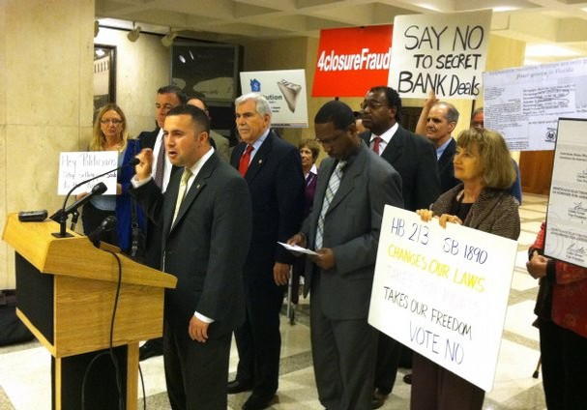
Florida Foreclosure Fight

Slide 81
FORECLOSURE QUICK FACTS
It is estimated that from 2009 through 2012, lost home equity wealth in Florida due to foreclosures is $331.3 billion.
The average loss per home due to nearby foreclosures is estimated to be $41,271.
The historic joint state-federal foreclosure settlement includes the country’s five largest loan servicers: Ally/GMAC, Bank of America, Citi, JPMorgan Chase, Wells Fargo; it is the largest consumer financial protection settlement in US history.
The State of Florida Long Range Financial Outlook for 2013 – 2016 finds that the “pace of Florida’s recovery will be driven in large measure by the time it takes the construction industry to revive.” The study goes on to find that “foreclosures have swelled the state’s unsold inventory of homes and will continue to do so in the near-term.”

Slide 82
F L O R I D A H O U S E O F R E P R E S E N T A T I V E S HB87
1 A bill to be entitled
2 An act relating to mortgage foreclosures; amending s.
3 95.11, F.S.; revising the limitations period for
4 commencing an action to enforce a claim of a
5 deficiency judgment after a foreclosure action;
6 providing for applicability to existing causes of
7 action; creating s. 702.015, F.S.; providing
8 legislative intent; specifying required contents of a
9 complaint seeking to foreclose on certain types of
10 residential properties with respect to the authority
11 of the plaintiff to foreclose on the note and the
12 location of the note; authorizing sanctions against
13 plaintiffs who fail to comply with complaint
14 requirements; providing for nonapplicability to
15 proceedings involving timeshare interests; creating s.
16 702.036, F.S.; requiring a court to treat a collateral

Slide 83
Florida Homeowners Bill of Rights
The Goal is to Discourage Foreclosures and Encourage Homeownership
We advocate for legislation that would:
ubar servicers from processing loan modifications and foreclosures simultaneously, which currently results in borrowers who are negotiating loan modifications wrongfully losing their homes
uprovide homeowners a single point of contact with the servicer to lead toward the best opportunity for success in seeking a loan modification
ucontrol the practice of force-placed insurance that often puts homeowners at risk of losing their home
urequire proper and accurate documents when a servicer seeks to foreclose
and, provide for strong but fair accountability.

Slide 84
Media – Getting Our Story Out

Slide 85
OP ED
Tallahassee Out of Touch With Realities of Florida Homeowners
During the State of the Union on Tuesday night, President Obama announced that his Administration would be launching a joint investigation into the abusive lending and packaging of risky mortgages that led to the housing crisis. According to the White House, the goal of this investigation will be to hold banks that broke the law accountable, and to help provide relief for homeowners struggling from the collapse of the housing market caused by this wrongdoing. ……..
As an Orlando pastor on the front lines of what has come to feel like a never-ending housing crisis, the President’s announcement is a welcome development. Last month, I joined fellow clergy, homeowners, workers and state legislators at events in Orlando and Miami to call for precisely such a federal investigation. ……
Go to www.focusorlando.org and join a growing number of Floridians pushing to hold the banks and government accountable for fixing the housing crisis.
Reverend Errol G. Thompson
Pastor, New Life Fellowship Missionary Baptist Church, Member of FOCUS
Board Chair, PICO United Florida

Slide 86
Passing/Defeating A Bill
Legislation Process: Sponsor-Bill Drafting- Committee Assignments-House/Senate Floor-Signed by Governor-Becomes Law
Our Role: Monitor- Legislative Visits- Legislative Delegation Meetings- Committee Testimonies-Commitments on Vote
Our Role with Media: Press Conferences, OP Ed, Constituent Calls, Social Media

Slide 87
Good News!
Hey Peter,
Thanks for all the information.
We have good news – it looks like the bill will NOT be brought before the Senate for a vote, so it looks that SB 1890 will not be passed this year. We will watch out for any tricky shenanigans, but I think as far as this bill goes we are in the clear.
Thanks again,
Dan Bruno
Senator Steve Oelrich

Slide 88
Questions & Answers

Slide 89
Contact Information
Karen Landry
State Director
RAISE Florida Network
klandry@waronpoverty.org
www.raisefloridanetwork.org
Wilhelmina A. Leigh
Senior Research Associate
Joint Center for Political and Economic Studies
wleigh@jointcenter.org
www.jointcenter.org
Peter Phillips
Executive Director
PICO United Florida
pphillips@picoflorida.org
www.picoflorida.org

