Slide 1
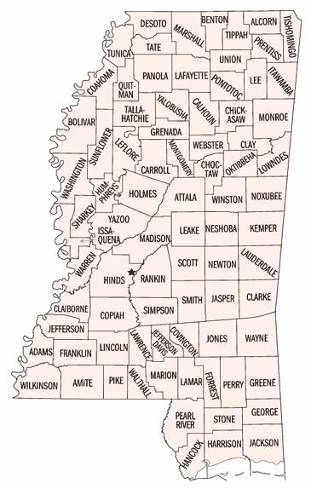
Engaging Legislative Champions for IDA Authorization in Mississippi Presentation by Wilhelmina A. Leigh Melissa R. Wells Joint Center for Political and Economic Studies at Coalition for a Prosperous Mississippi Partner Meeting Jackson, Mississippi October 2, 2013

Slide 2
How to Identify Legislative Champions

Slide 3
Step One: Analyze Legislature
Which legislators represent you?
Which legislators serve on committees relevant to your policy interests?
Which party is in majority in House and Senate?

Slide 4
Step Two: Gather Information About Legislators
… population mix in their districts
… needs in districts of legislators
… previously sponsored relevant legislation
… personal and professional connections
… information about legislators from other kindred organizations

Slide 5
Step Three: Develop Policy Strategy
Based on your “homework,” decide
which legislators to engage and, thereby,
generate interest around the state and
across party lines

Slide 6
Factors for Choosing Potential Champions for IDA Authorization
District Socio-Demographics
Committee Membership
Political Ideology
Statewide Geographic Representation
Notes:
Talking Points
Demographics - Identified legislative districts that have counties with a large population of people in poverty
Committee membership – Identified legislators on committees relevant to, or that have jurisdiction over your policy interests
Political Ideology – Work across party lines to develop bi-partisan support for your policy interests
Statewide Geographic Representation – Illustrate the need for policy change in districts across the state

Slide 7
Where do Mississippians Live?
Percent of African Americans by County (2010)
Percent of White Americans by County (2010)

Slide 8
Percent of People in Poverty by County (2010)
Where do the Poorest Mississippians Live?
Notes:
Presenter- Mention that the percent of blacks (37 %) and whites (58%) is comparable to the share of each racial group for the entire state, yet the county poverty rate (58%) exceeds the state poverty rate (21%)

Slide 9
IDA Authorization: Relevant Committees
HOUSE OF REPRESENTATIVES
Banking and Financial Services
Municipalities
Public Health and Human Services
Ways and Means
Youth and Family Affairs

Slide 10
IDA Authorization: Relevant House Committee (Banking and Financial Services)
Banking and Financial Services Committee
Henry Zuber III [R-113] Chair
Lester Carpenter [R-1] Vice Chair
William Tracy Arnold [R-3]
Kimberly Campbell Buck [D-72]
Mary H. Coleman [D-65]
Andy Gipson [R-77]
Jeffrey S. Guice [R-114]
Joey Hood [R-35]
Nolan Mettetal [R-10]
Bobby Moak [D-53]
Ray Rogers [R-61]
Gary V. Staples [R-88]
Jerry R. Turner [R-18]
Adrienne Wooten [D-71]
African-American Legislator

Slide 11
IDA Authorization: Relevant House Committee (Municipalities)
Committee on Municipalities
Edward Blackmon, Jr. [D-57] Chair
David W. Myers [D-98] Vice Chair
Gene Alday [R-25]
Mark Baker [R-74]
Lester Carpenter [R-1]
Linda F. Coleman [D-29]
William C. “Bill” Denny [R-64]
Deborah Butler Dixon [D-63]
Michael T. Evans [D-43]
Eugene Forrest Hamilton [R-6]
Gregory Holloway [D-76]
Rita Martinson [R-58]
Margaret Rogers [R-14]
Randy Rushing [R-78]
Greg Snowden [R-83]
Tom Weathersby [R-62]
African-American Legislator

Slide 12
IDA Authorization: Relevant House Committee (Public Health and Human Services)
Committee on Public Health and Human Services
Sam C. Mims,V [R-97] Chair Toby Baker [R-74] Vice Chair Brian Aldrige [R-67]
Chris Brown [R-20]
Cecil Brown [D-66]
Kimberly Campbell Buck [D-72]
Bryant W. Clark [D-47]
Mary H. Coleman [D-65]
Carolyn Crawford [R-121]
Becky Currie [R-92]
Dennis DeBar, Jr. [R-105]
James “Jim” Evans [D-70]
Eugene Forrest Hamilton [R-6]
John W. Hines, Sr. [D-50]
Joey Hood [R-35]
Kevin Horan [D-24]
Bobby B. Howell [R-46]
Hank Lott [R-101]
Brad Mayo [R-12]
Tom Miles [D-75]
Bobby Moak [D-53]
Brent Powell [R-59]
John Read [R-112]
Randy Rushing [R-78]
Bobby Shows [R-89]
Jeffrey C. Smith [R-39]
Linda Whittington [D-34]
Sonya Williams-Barnes [D-119]
African-American Legislator

Slide 13
IDA Authorization: Relevant House Committee (Ways and Means)
Committee on Ways and Means
Jeffrey C. Smith [R-39] Chair Ray Rogers [R-61] Vice Chair Brian Aldrige [R-67]
Mark Baker [R-74]
Richard Bennett [R-120]
Edward Blackmon, Jr. [D-57]
Chris Brown [R-20]
Credell Calhoun [D-68]
Gary Chism [R-37]
Dennis DeBar, Jr. [R-105]
Tyrone Ellis [D-38]
James “Jim” Evans [D-70]
Mark Formby [R-108]
Andy Gipson [R-77]
Eugene Forrest Hamilton [R-6]
Esther Harrison [D-41]
D. Stephen Holland [D-16]
Stephen A. “Steve” Horne [R-81]
Sherra Hillman Lane [D-86]
Bennett Malone [D-45]
Rita Martinson [R-58]
Brad Mayo [R-12]
Bobby Moak [D-53]
Alex Monsour [R-54]
Thomas U. Reynolds [D-33]
Omeria Scott [D-80]
Ferr Smith [D-27]
Gary V. Staples [R-88]
Johnny W. Stringer [D-87]
Tom Weathersby [R-62]
Henry Zuber III [R-113]
African-American Legislator

Slide 14
IDA Authorization: Relevant House Committee (Youth and Family Affairs)
Committee on Youth and Family Affairs
John W. Hines [D-50] Chair Sara R. Thomas [D-31] Vice Chair Gene Alday [R-25]
William T. Arnold [R-3]
Nick Bain [D-2]
Manly Barton [R-109]
Donnie Bell [R-21]
Clara H. Burnett[D-9]
Alyce G. Clark [D-69]
Deborah Butler Dixon [D-63]
Greg Haney [R-118]
D. Stephen Holland [D-16]
Wanda T. Jennings[R-7]
Bill Kinkade [R-52]
Timmy Ladner [R-93]
Hank Lott [R-101]
Steve Massengil [R-13]
Sam C. Mims, V [R-97]
Willie J. Perkins, Sr. [D-32]
Bill Pigott [R-99]
Margaret E. Rogers [R-14]
William Shirley[R-84]
Linda Whittington [D-34]
Charles Young, Jr.[D-82]
African-American Legislator

Slide 15
IDA Authorization: House Member Districts with Potential Champions
Northern
District 9
District 10
Central
District 28
District 31
District 32
District 34
District 42
District 48
District 54
District 61
Southwest
District 96
Southeast
District 114

Slide 16
IDA Authorization: Potential Champions (House)

Slide 17
IDA Authorization: House Member Districts (by County) with Potential Champions – Northern
Northern
District 9
(Coahoma, Panola, Quitman, Tate, Tunica)
District 10
(Lafayette, Panola, Tallahatchie)

Slide 18
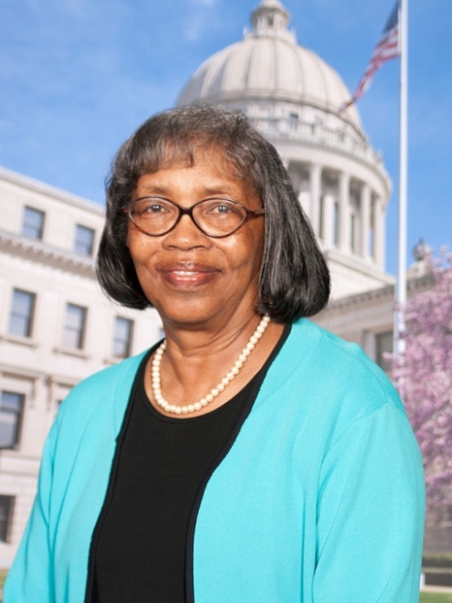
Rep. Clara H. Burnett (D-09)
Committee Assignments
Gaming (Vice Chair)
Education
Tourism
Universities and Colleges
Youth and Family Affairs
Counties Covered by District
Coahoma, Panola, Quitman, Tate, Tunica
Affiliations
She is a member of the Methodist faith.
Relevant Legislation
Co-sponsored bill to extend financial literacy programs from grades 10 and 11 to grades 9 through 12 (HB 31)
Introduced bill to authorize Board of Supervisors of Tunica County to contribute funds to the Tunica County Economic Development Foundation, Inc. (HB 1778)
Introduced bill to authorize Board of Supervisors of Tunica County to contribute funds for calendar year 2007 to the Institute of Community Services, Inc., to operate Head Start Program (HB 1759)

Slide 19
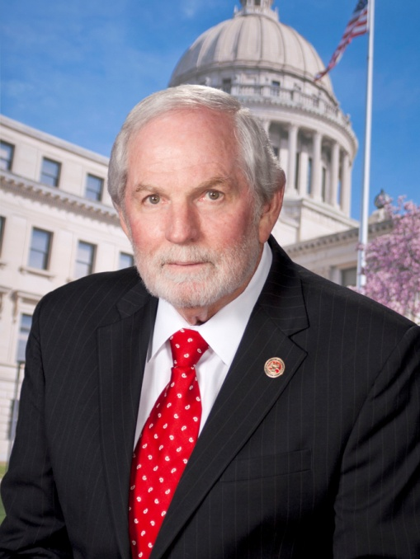
Rep. Nolan Mettetal (R-10)
Committee Assignments
Universities and Colleges (Chair)
Appropriations
Banking and Financial Services
Corrections
Medicaid
Public Property
Public Utilities
Select Committee on Railway Development
Workforce Development
Counties Covered by District
Lafayette, Panola, Tallahatchie
Affiliations
University of Mississippi Alumni Association
Northwest Community College Alumni Association
He is a member of the Methodist faith.
Relevant Legislation
Introduced bill to revise comprehensive investment plan and investment options for the Mississippi Prepaid Affordable College Tuition program (HB 522)
Co-sponsored bill to authorize an income tax credit for taxpayers who are first-time homebuyers of a principal residence in the state of Mississippi (SB 2139)
Notes:
He was first elected as a Democrat and changed his affiliation to Republican in 2008. He served in the MS Senate from 1996 to 2012 and was elected to the House in 2012.

Slide 20
IDA Authorization: House Member Districts (by County) with Potential Champions – Central
Central
District 28
(Bolivar, Sunflower, Washington)
District 31
(Sunflower)
District 32
(Leflore)
District 34
(Carroll, Holmes, Humphreys, Leflore, Montgomery, Washington)
District 42
(Kemper, Lauderdale, Noxubee)
District 48
(Attala, Carroll, Choctaw, Holmes, Humphreys, Leake)
District 54
(Issaquena, Sharkey, Warren)
District 61
(Rankin)

Slide 21
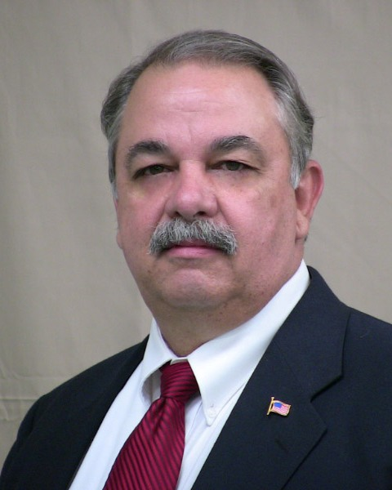
Rep. Tommy Taylor (R-28)
Committee Assignments
Agriculture
Corrections
County Affairs
Judiciary B
Judiciary En Banc
Military Affairs
Universities and Colleges
Counties Covered by District
Bolivar, Sunflower, Washington
Affiliations
American Correctional Association
He is a member of the Baptist faith.
Notes:
MRW: The representative’s district has a sizeable African-American population and includes counties with a large portion of people in poverty. Did not identify legislation introduced by the member that is relevant to asset-building or individual development accounts and the representative is not on an IDA relevant committee.

Slide 22
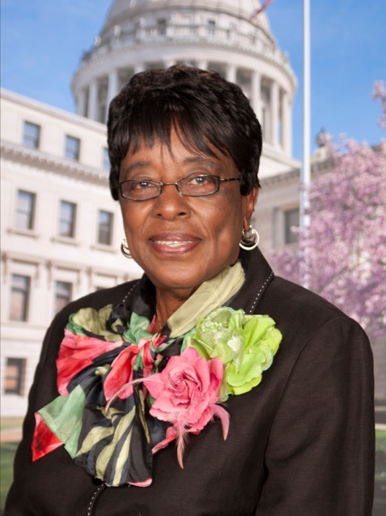
Rep. Sara R. Thomas (D-31)
Committee Assignments
Youth and Family Affairs (Vice Chair)
Agriculture
Corrections
Education
Ethics
Investigate State Offices
Counties Covered by District
Sunflower
Affiliations
Mississippi Association of Educators
National Association of Educators
Mississippi Retired Teachers
She is a member of the Baptist faith.
Relevant Legislation
Co-sponsored bill to create a College and Career Readiness Program (HB 916)
Co-sponsored bill to extend financial literacy programs from grades 10 and 11 to grades 9 through 12 (HB 31)
Co-sponsored resolution urging the state of Mississippi to take critical and fundamental actions to improve the state’s economic and social rankings (HC 34)

Slide 23
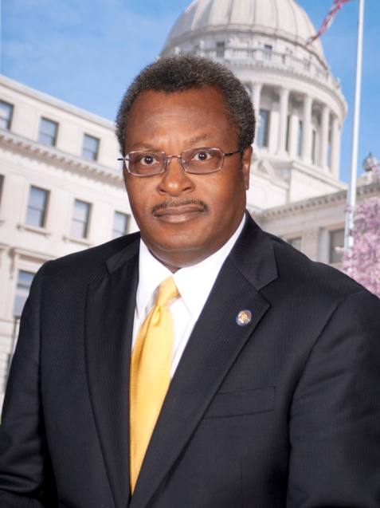
Rep. Willie J. Perkins, Sr. (D-32)
Committee Assignments
Apportionment and Elections
Appropriations
Judiciary A
Judiciary En Banc
Management
Youth and Family Affairs
Counties Covered by District
Leflore
Affiliations
Board Attorney for Leflore County school district and the city of Itta Bena
NAACP (Leflore)
He is a member of the Baptist faith.
Relevant Legislation
Co-sponsored bill to extend financial literacy programs from grades 10 and 11 to grades 9 through 12 (HB 31)
Co-sponsored bill to create a joint study committee on children and family issues with an emphasis on promoting educational attainment, and reducing disparities in education and income (HB 1203)

Slide 24
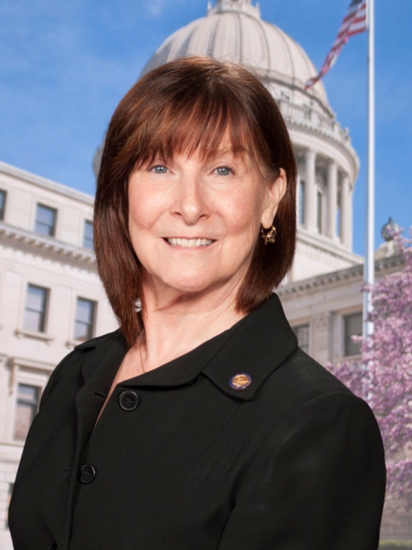
Rep. Linda Whittington (D-34)
Committee Assignments
Tourism (Vice Chair)
Agriculture
Corrections
Public Health and Human Services
Select Committee on Railway Development
Youth and Family Affairs
Counties Covered by District
Carroll, Holmes, Humphreys, Leflore, Montgomery, Washington
Affiliations
Chamber of Commerce Board (Greenwood-Leflore County)
She is a member of the Episcopal faith.
Relevant Legislation
Co-sponsored resolution urging the state of Mississippi to take critical and fundamental actions to improve the state’s economic and social rankings (HC 34)

Slide 25
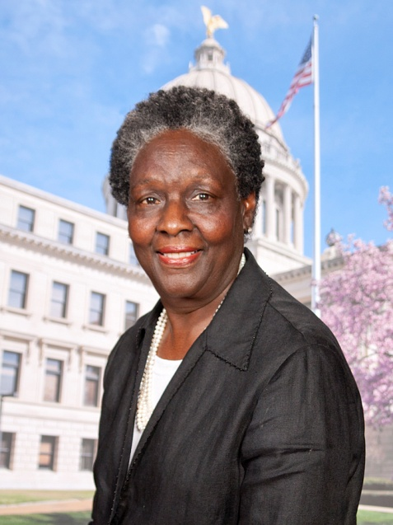
Rep. Reecy L. Dickson (D-42)
Committee Assignments
Appropriations
Corrections
Education
Insurance
Workforce Development
Counties Covered by District
Kemper, Lauderdale, Noxubee
Affiliations
NAACP
She is a member of the Baptist faith.
Relevant Legislation
Introduced bill to authorize individual development accounts for low-income individuals (HB 1386)
Introduced bill to create a commission on and a department of Health, Human Services and Economic Security (HB 360)
Introduced bill to create Mississippi Poverty Reduction and Advocacy Office (HB 443)
Notes:
Rep. Dickson introduced the IDA bill during the 2013 legislative session

Slide 26
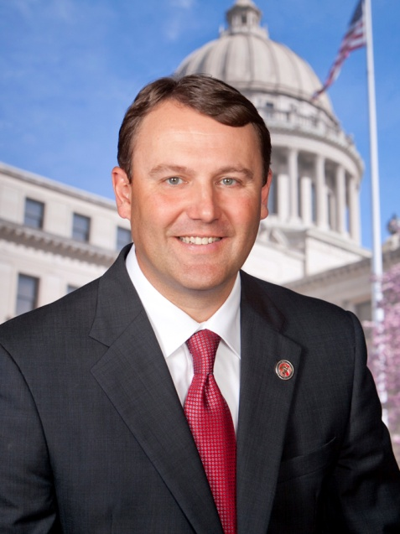
Rep. Jason White (R-48)
Committee Assignments
Constitution (Vice Chair)
Agriculture
Apportionment and Elections
Congressional Redistricting
Judiciary B
Judiciary En Banc
Legislative Reapportionment
Medicaid
Select Committee on Railway Development
Transportation
Wildlife, Fisheries and Parks
Counties Covered by District
Attala, Carroll, Choctaw, Holmes, Humphreys, Leake
Affiliations
Mississippi Bar Association
Attala County Farmer Co-op, Board of Director
He is a member of the Baptist faith.
Notes:
MRW: The representative’s district has a sizeable African-American population and includes counties with a large portion of people in poverty. Did not identify legislation introduced by the member that is relevant to asset-building or individual development accounts and the representative is not on an IDA relevant committee.
Rep was elected a Democrat in 2011 and changed affiliation to Republican in 2012

Slide 27
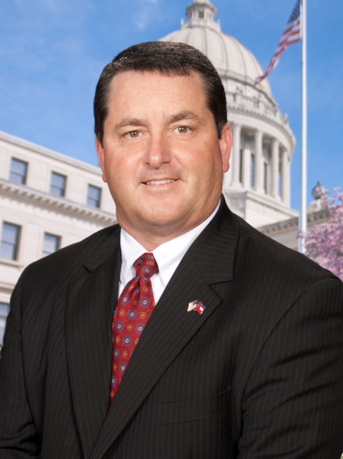
Rep. Alex Monsour (R-54)
Committee Assignments
Ports, Harbors and Airports (Chair)
Constitution
Gaming
Judiciary B
Judiciary En Banc
Public Property
Tourism
Ways and Means
Counties Covered by District
Issaquena, Sharkey, Warren
Affiliations
He is a member of the Catholic faith.
Relevant Legislation
Co-sponsored resolution urging the state of Mississippi to take critical and fundamental actions to improve the state’s economic and social rankings (HC 34)

Slide 28
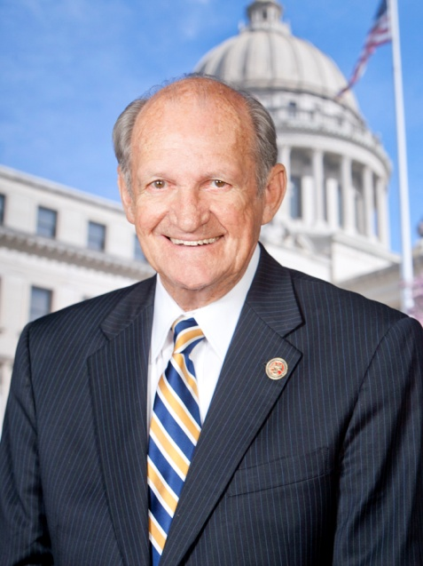
Rep. Ray Rogers (R-61)
Committee Assignments
Performance Evaluation and Expenditure Review (Chair)
Ways and Means (Vice Chair)
Banking and Financial Services
Investigate State Offices
Management
Military Affairs
Counties Covered by District
Rankin
Affiliations
He is a member of the Methodist faith.
Notes:
MRW: Did not identify legislation introduced by the member that is relevant to asset-building or individual development accounts (IDA)

Slide 29
IDA Authorization: House Member Districts (by County) with Potential Champions – Southwest
Southwest
District 96
(Adams, Amite, Pike, Wilkinson)

Slide 30
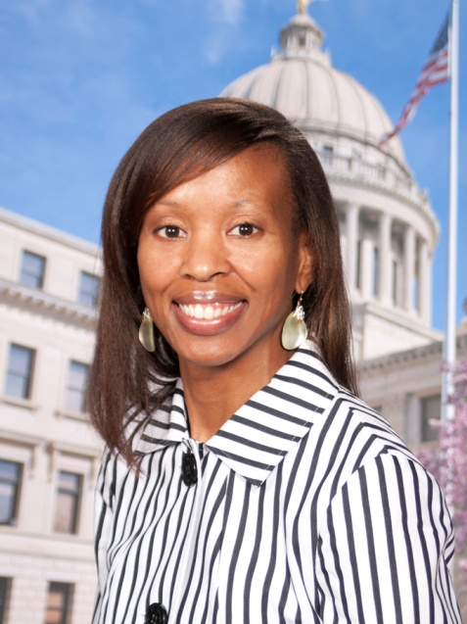
Rep. Angela Cockerham (D-96)
Committee Assignments
Energy (Chair)
Compilation, Revision and Publication
Ethics
Judiciary A
Judiciary En Banc
Management
Public Property
Wildlife, Fisheries and Parks
Counties Covered by District
Adams, Amite, Pike, Wilkinson
Affiliations
Bar Association (Mississippi & Louisiana)
She is a member of the Baptist faith.
Relevant Legislation
Co-sponsored resolution urging the state of Mississippi to take critical and fundamental actions to improve the state’s economic and social rankings (HC 34)
Co-sponsored bill to create a joint study committee on children and family issues with an emphasis on promoting educational attainment, and reducing disparities in education and income (HB 1203)

Slide 31
IDA Authorization: House Member Districts (by County) with Potential Champions – Southeast
Southeast
District 114
(Harrison, Jackson)

Slide 32
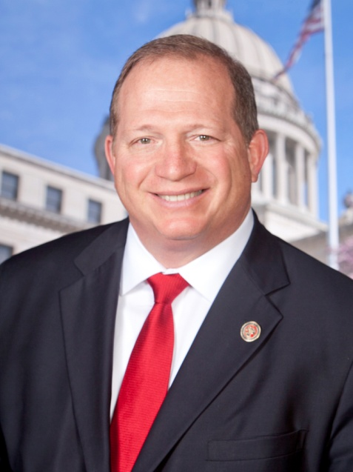
Rep. Jeffrey S. Guice (R-114)
Committee Assignments
Marine Resources (Vice Chair)
Banking and Financial Services
Education
Insurance
Judiciary B
Judiciary En Banc
Ports, Harbors and Airports
Wildlife, Fisheries and Parks
Counties Covered by District
Harrison, Jackson
Affiliations
National Association of Realtors
Boys and Girls Club of the Gulf Coast (Board of Directors)
He is a member of the Presbyterian faith.
Relevant Legislation
Co-sponsored resolution urging the state of Mississippi to take critical and fundamental actions to improve the state’s economic and social rankings (HC 34)

Slide 33
IDA Authorization: Relevant Committees
SENATE
Business and Financial Institutions
Economic Development
Finance
Municipalities
Public Health and Welfare

Slide 34
IDA Authorization: Relevant Senate Committee (Business and Financial Institutions)
Committee on Business and Financial Institutions
Gary Jackson [R-15] Chair
J. P. Wilemon, Jr. [D-5] Vice Chair Nickey Browning [R-3]
Kelvin E. Butler [D-38]
Videt Carmichael [R-33]
Sally Doty [R-39]
Josh Harkins [R-20]
Robert L. Jackson [D-11]
Will Longwitz [R-25]
Haskins Montgomery [D-34]
Rita P. Parks [R-4]
Bill Stone [D-2]
Giles Ward [R-18]
African-American Legislator

Slide 35
IDA Authorization: Relevant Senate Committee (Economic Development)
Committee on Economic Development
John Horhn [D-26] Chair
Steve Hale [D-10] Vice Chair Terry W. Brown [R-17]
Eugene S. Clarke [R-22]
Sally Doty [R-39]
Joey Fillingane [R-41]
Tommy A. Gollott [R-50]
Haskins Montgomery [D-34]
Philip Moran [R-46]
David Parker [R-19]
Rita P. Parks [R-4]
African-American Legislator

Slide 36
IDA Authorization: Relevant Senate Committee (Finance)
Committee on Finance
Joey Fillingane [R-41] Chair
Dean Kirby [R-30] Vice Chair Nickey Browning [R-3]
Hob Bryan [D-7]
Kelvin E. Butler [D-38]
Lydia G. Chassaniol [R-14]
Deborah J. Dawkins [D-48]
Sally Doty [R-39]
Steve Hale [D-10]
Josh Harkins [R-20]
Billy Hudson [ R-45]
Kenneth W. Jones [D-21]
David Jordan [D-24]
Will Longwitz [R-25]
Chris Massey [R-1]
Haskins Montgomery [D-34]
Philip Moran [R-46]
David Parker [R-19]
Rita P. Parks [R-4]
John A. Polk [R-44]
Derrick T. Simmons [D-12]
Tony Smith [R-47]
Bill Stone [D-2]
Gray Tollison [R-9]
Giles Ward [R-18]
Michael Watson [R-51]
African-American Legislator

Slide 37
IDA Authorization: Relevant Senate Committee (Municipalities)
Committee on Municipalities
J. P. Wilemon, Jr. [D-5] Chair
Bill Stone [D-2] Vice Chair Terry C. Burton [R-31]
Kelvin E. Butler [D-38]
Lydia G. Chassaniol [R-14]
Kenneth W. Jones [D-21]
David Jordan [D-24]
Perry Lee [R-35]
Chris Massey [R-1]
Chris McDaniel [R-42]
Melanie Sojourner [R-37]
African-American Legislator

Slide 38
IDA Authorization: Relevant Senate Committee (Public Health and Welfare)
Committee on Public Health and Welfare
Dean Kirby [R-30] Chair
Hob Bryan [D-7] Vice Chair David Blount [D-29]
Terry C. Burton [R-31]
Nancy A. Collins [R-6]
Joey Fillingane [R-41]
Hillman T. Frazier [D-27]
Josh Harkins [R-20]
W. Briggs Hopson, III [R-23]
John Horhn [D-26]
Gary Jackson [R-15]
Kenneth W. Jones [D-21]
David Parker [R-19]
Rita P. Parks [R-4]
Willie Simmons [D-13]
Tony Smith [R-47]
Melanie Sojourner [R-37]
Gray Tollison [R-9]
Brice Wiggins [R-52]
African-American Legislator

Slide 39
IDA Authorization: Senate Member Districts with Potential Champions
Northern
District 9
District 10
District 11
Central
District 13
District 21
District 22
District 24
District 30
District 32
Southeast
District 50
Southwest
District 38

Slide 40
IDA Authorization: Potential Champions (Senate)

Slide 41
IDA Authorization: Senate Member Districts (by County) with Potential Champions – Northern
Northern
District 9
(Lafayette, Tallahatchie, Yalobusha)
District 10
(Panola, Tate)
District 11
(Coahoma, Quitman, Tate, Tunica)

Slide 42
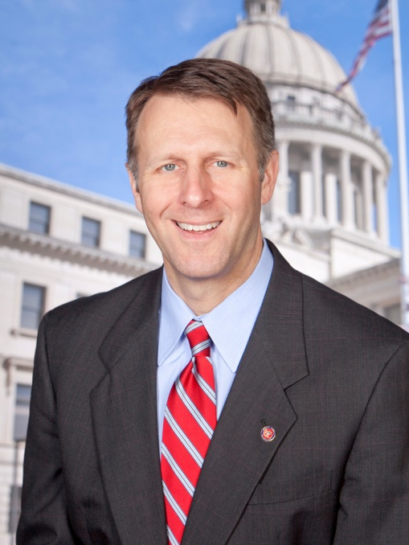
Sen. Gray Tollison (R-09)
Committee Assignments
Education (Chair)
Executive Contingent Fund (Vice Chair)
Constitution
Finance
Judiciary, Division B
Public Health and Welfare
Rules
Universities and Colleges
Wildlife, Fisheries and Parks
Counties Covered by District
Lafayette, Tallahatchie, Yalobusha
Relevant Legislation
Introduced bill to authorize a tax deduction for college savings plans (SB 2204)
Notes:
MRW: No affiliations were listed for Sen. Tollison

Slide 43
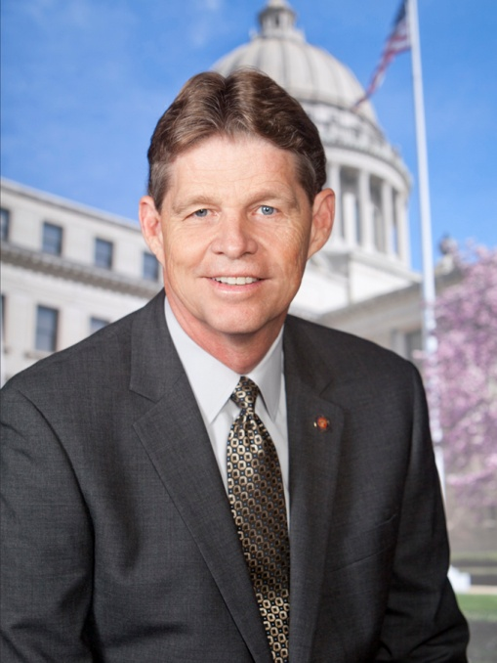
Sen. Steve Hale (D-10)
Committee Assignments
Economic Development (Vice Chair)
Accountability, Efficiency, Transparency
Education
Finance
Investigate State Offices
Judiciary, Division A
Universities and Colleges
Counties Covered by District
Panola, Tate
Affiliations
He is a member of the Baptist faith.
Relevant Legislation
Introduced bill to authorize assessment of economic development incentives, including the development and expansion of small businesses (SB 2054)

Slide 44
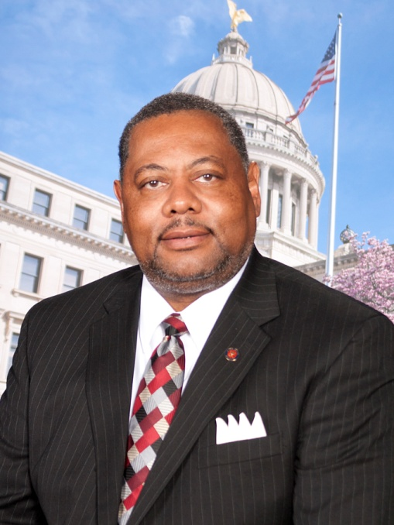
Sen. Robert L. Jackson (D-11)
Committee Assignments
Executive Contingent Fund (Chair)
Labor (Vice Chair)
Agriculture
Appropriations
Business and Financial Institutions
Energy
Ports and Marine Resources
Public Property
Counties Covered by District
Coahoma, Quitman, Tate, Tunica
Affiliations
21st Century Investment Club
Quitman County Social Service Club for Senior Citizens
He is a member of the Baptist faith.
Relevant Legislation
Introduced two pieces of legislation during the 2013 session to establish an IDA program for low-income individuals (SB 2027 & SB 2741)
Co-sponsored bill to authorize an income tax credit for taxpayers who are first-time homebuyers of a principal residence in the state of Mississippi (SB 2139)
Notes:
Introduced both IDA bills during the 2013 legislative session

Slide 45
IDA Authorization: Senate Member Districts (by County) with Potential Champions – Central
Central
District 13
(Bolivar, Humphreys, Sunflower)
District 21
(Attala, Holmes, Madison, Yazoo)
District 22
(Bolivar, Humphreys, Sharkey, Washington, Yazoo)
District 24
(Holmes, Leflore, Tallahatchie)
District 30
(Rankin)
District 32
(Kemper, Lauderdale, Noxubee, Winston)

Slide 46
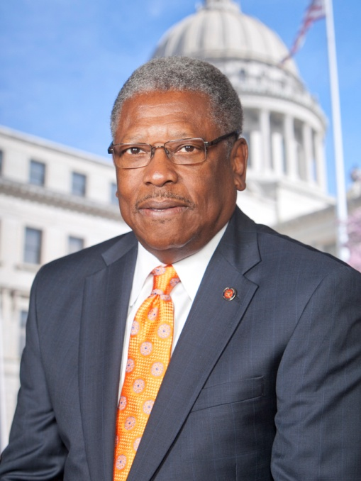
Sen. Willie Simmons (D-13)
Committee Assignments
Highways and Transportation (Chair)
Agriculture
Appropriations
Corrections
Legislative Budget Committee
Ports and Marine Resources
Public Health and Welfare
State Library
Counties Covered by District
Bolivar, Humphreys, Sunflower
Affiliations
Cleveland Area Civic Club
100 Black Men of Bolivar County
National Association of State Legislators
National Association of Black State Legislators
MS Association of Professionals in Corrections
He is a member of the Solomon Chapel AME Church.
Relevant Legislation
Introduced bill to authorize an IDA program for low-income individuals (SB 2113)
Co-sponsored bill to authorize an IDA program for low-income individuals (SB 2741)
Notes:
Introduced and co-sponsored IDA bills during the 2013 legislative session. The Senator also introduced an IDA bill during the 2012 session (SB 2587)

Slide 47
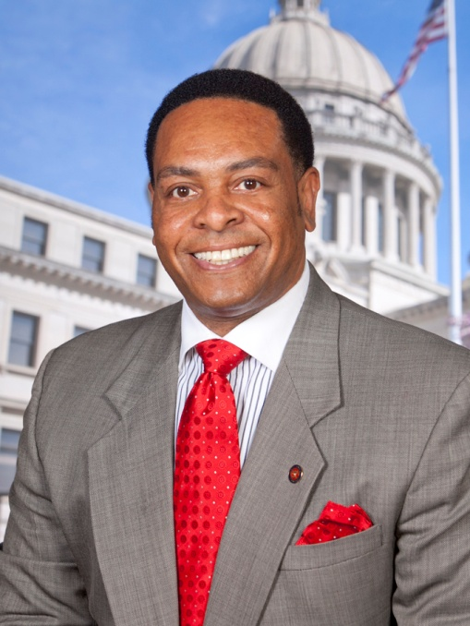
Sen. Kenneth W. Jones (D-21)
Committee Assignments
Interstate and Federal Cooperation (Chair)
Constitution
Environment Protection, Conservation and Water Resources
Executive Contingent Fund
Finance
Insurance
Municipalities
Public Health and Welfare
Counties Covered by District
Attala, Holmes, Madison, Yazoo
Affiliations
Mississippi Legislative Black Caucus (Chair)
NBC-LEO
He is a member of the Baptist faith.
Relevant Legislation
Co-sponsored bill to authorize an IDA program for low-income individuals (SB 2587)
Sponsored bill to create a study committee to study economic development in low-income census tracts (SC 684)
Introduced bill to create the Mississippi Small Business Opportunities Programs and authorize bonds to provide loans and grants to small businesses (SB 3063)

Slide 48
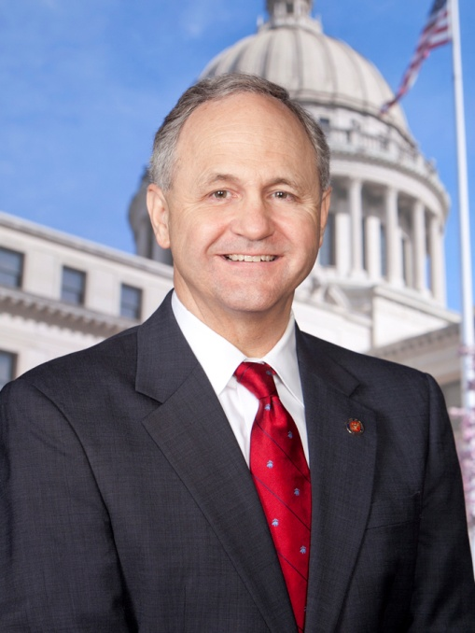
Sen. Eugene S. Clarke (R-22)
Committee Assignments
Appropriations (Chair)
Accountability, Efficiency, Transparency
Agriculture
Congressional Redistricting
Economic Development
Housing
Insurance
Judiciary, Division A
Legislative Budget Committee
Legislative Reapportionment
Ports and Marine Resources
Counties Covered by District
Bolivar, Humphreys, Sharkey, Washington, Yazoo
Affiliations
He is a member of the Methodist faith.
Relevant Legislation
Co-sponsored the Mississippi Small Business Regulatory Act to create procedures to analyze the economic impact on and availability of more flexible approaches for small businesses (SC 2398)

Slide 49
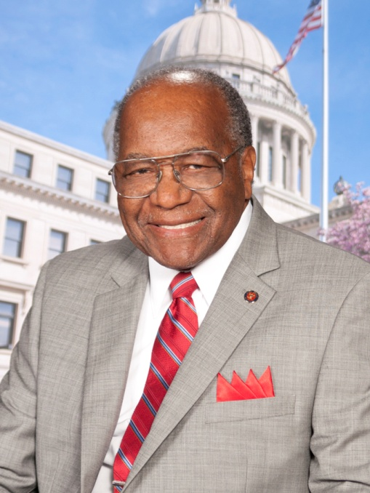
Sen. David Jordan (D-24)
Committee Assignments
Drug Policy (Chair)
Agriculture
County Affairs
Education
Environment Protection, Conservation and Water Resources
Finance
Forestry
Housing
Municipalities
Tourism
Counties Covered by District
Holmes, Leflore, Tallahatchie
Affiliations
Greenwood County Councilman (Vice President)
He is a member of the Baptist faith.
Relevant Legislation
Co-sponsored bill to authorize individual development accounts for low-income individuals (SB 2587)
Co-sponsored bill to authorize an income tax credit for taxpayers who are first-time homebuyers of a principal residence in the state of Mississippi (SB 2139)
Notes:
Currently serving as Vice President of the Greenwood city council

Slide 50
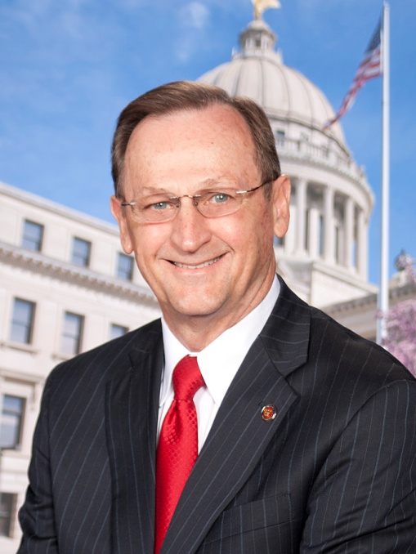
Sen. Dean Kirby (R-30)
Committee Assignments
Public Health and Welfare (Chair)
Finance (Vice Chair)
Corrections
Highways and Transportation
Housing
Insurance
Interstate and Federal Cooperation
Judiciary, Division A
Legislative Budget Committee
Counties Covered by District
Rankin
Affiliations
Chamber of Commerce (Pearl and Rankin Counties)
He is a member the Baptist faith.
Relevant Legislation
Introduced two pieces of legislation to authorize an income tax credit for taxpayers who are first-time homebuyers of a principal residence in the state of Mississippi – SB 2139 ( 2011 session) and SB 2327 (2010 session)

Slide 51
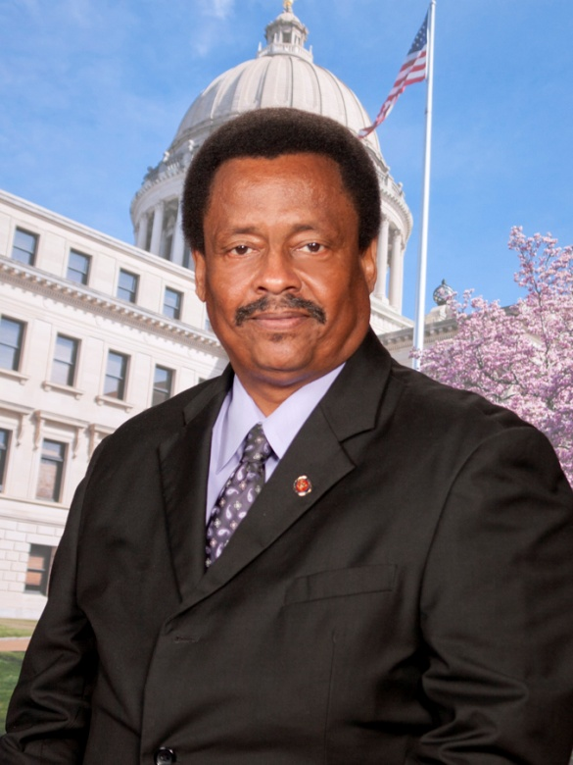
Sen. Sampson Jackson II (D-32)
Committee Assignments
Corrections (Chair)
Interstate and Federal Cooperation (Vice Chair)
Appropriations
Energy
Judiciary, Division B
Performance Evaluation and Expenditure Review
Veterans and Military Affairs
Wildlife, Fisheries and Parks
Counties Covered by District
Kemper, Lauderdale, Noxubee, Winston
Affiliations
NAACP
Kemper County Political Black Caucus
Mississippi Farm Bureau
Mississippi Cattlemen's Association
He is a member the Baptist faith.
Relevant Legislation
Co-sponsored bill to authorize an IDA program for low-income individuals (SB 2587)
Co-sponsored bill to authorize an income tax credit for taxpayers who are first-time homebuyers of a principal residence in the state of Mississippi (SB 2139)

Slide 52
IDA Authorization: Senate Member Districts (by County) with Potential Champions – Southwest
Southwest
District 38
(Adams, Amite, Pike, Walthall, Wilkinson)

Slide 53
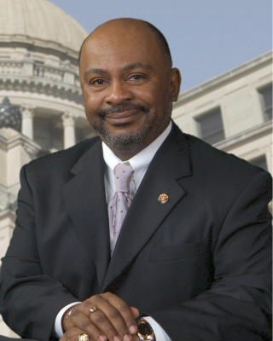
Sen. Kelvin E. Butler (D-38)
Committee Assignments
Labor (Chair)
Enrolled Bills (Vice Chair)
Business and Financial Institutions
Energy
Finance
Highways and Transportation
Judiciary, Division A
Local and Private
Municipalities
Performance Evaluation and Expenditure Review
State Library
Tourism
Counties Covered by District
Adams, Amite, Pike, Walthall, Wilkinson
Affiliations
Magnolia South Pike Chamber of Commerce
NAACP
He is a member the Baptist faith.
Relevant Legislation
Co-sponsored bill to authorize an income tax credit for taxpayers who are first-time homebuyers of a principal residence in the state of Mississippi (SB 2139)

Slide 54
IDA Authorization: Senate Member Districts (by County) with Potential Champions – Southeast
Southeast
District 50
(Harrison)

Slide 55
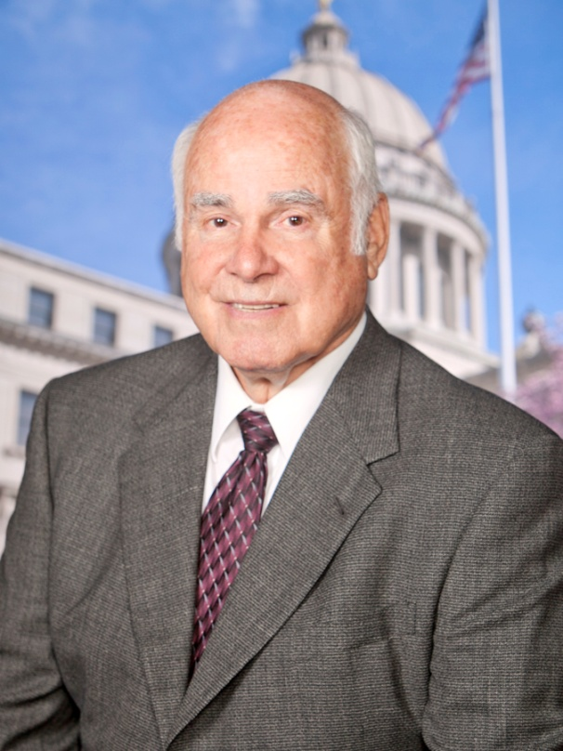
Sen. Tommy A. Gollott (R-50)
Committee Assignments
Environment Protection, Conservation and Water Resources (Chair)
Appropriations
Drug Policy
Economic Development
Elections
Highways and Transportation
Local and Private
Performance Evaluation and Expenditure Review
Ports and Marine Resources
Tourism
Counties Covered by District
Harrison
Affiliations
National Society of State Legislators
Mississippi Arts Fair for Handicapped (Board Member)
Chesire Home for Handicapped (Board Member)
He is a member of the Catholic faith.
Relevant Legislation
Co-sponsored bill to authorize an income tax credit for taxpayers who are first-time homebuyers of a principal residence in the state of Mississippi (SB 2327)
Co-sponsored the Mississippi Small Business Regulatory Act to create procedures to analyze the economic impact on and availability of more flexible approaches for small businesses (SC 2398)

Slide 56
How to Identify Champions
Research the characteristics of House and Senate districts—and their members—across the state
Examine membership of committees likely to have jurisdiction to consider your issue
Based on this “homework,” select the senators and representatives who are most likely to be supportive of your issue and reach out to them
Joint Center for Political and Economic Studies

